Slide 1

Using ASEE Data

Slide 2
Agenda
Data Collected
Timeframes
Historical Notes
Departments, Research Centers and Programs
Excel Sheet (generated via Python + Claude)
We're focusing on the data from our Profiles of Engineering + Engineering Technology Data Annual Collection and the most used

Slide 3
Data Collected
Degrees Awarded
Race/Ethnicity, Gender, Degree Level, Program Name, Program Discipline, Department Name, Department Discipline
Enrollment
Race/Ethnicity, Gender, Class, Status, Degree Level, Program Name, Program Discipline, Department Name, Department Discipline
Tenure-Track Faculty Headcount
Rank,Race/Ethnicity, Gender, Department Name, Department Discipline
Research Expenditures
Department Name, Department Discipline, Source, Total Grants
Engineering Research Center Name, Location, ERC Discipline
Other Data: Personnel (Research and Teaching, Stipends, Graduate Assistantships.

Slide 4
Timeframes (Profiles 2024)
Fall 2024: institution enrollments, engineering college enrollments, engineering technology college enrollments, faculty head counts, admission requirements and recommendations, and personnel information. If you need an as-of date for the data pull, please use November 1, 2024 (IPEDS) or your institution’s census date for courses.
July 1, 2023–June 30, 2024: Degrees awarded
FY 2024 for Research Expenditures: Most institutions have a FY aligned with the academic year above (July 1, 2023 to June 30, 2024) there are handful of exceptions to this (FY 24 aligns with an October 1 start date or annual calendar).

Slide 5
Relevant History
1999-present
1999-2005: Enrollment not collected at detailed demographic level just class + status (part-time versus full-time)
2011: Race/ethnicity categories adjusted to match same change in IPEDS
2012: Disciplines Expanded
2019: Non-participating Institutions degrees awarded data pulled from IPEDS
2020: Two new gender categories: Non-Binary and Another or Unknown Gender for all demographics

Slide 6
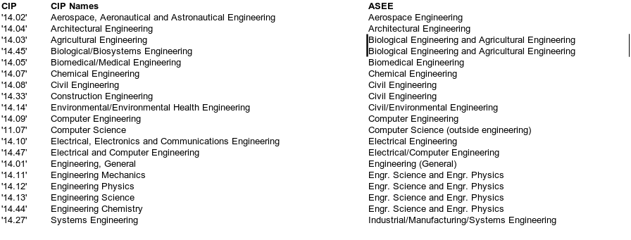
CIP (IPEDS) to ASEE Disciplines

Slide 7
Structure of the Data for Discipline (ASEE Reports + Pubs)
Departments Discipline
Faculty (Tenured/Tenure-Track)
Teaching Research Personnel
Stipends
Research Expenditures
Degree Program Discipline
Enrollment
Degrees Awarded
Degree Characteristics
Engineering Research Centers Discipline
Stipends
Research Expenditures

Slide 8
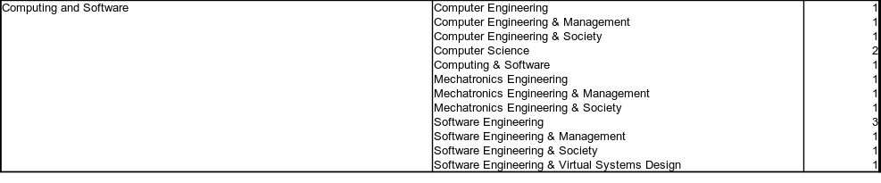
Department versus Programs

Slide 9
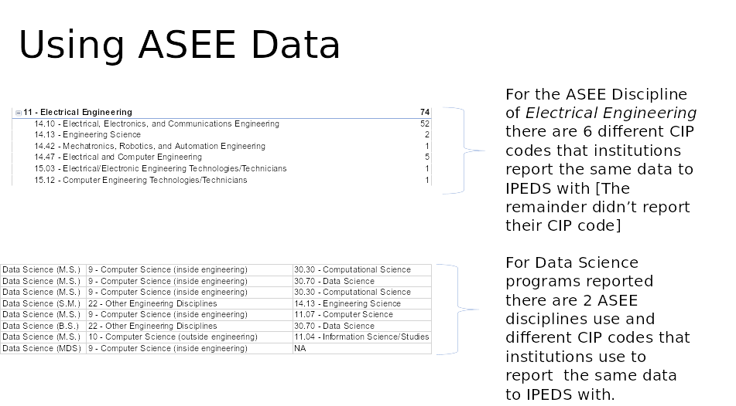

Slide 10
Program Discipline Changes
We flag discipline changes for a degree program year to year.
There is a historical division in 14 and 15 series CIP coded programs (Engineering & Engineering Technology) due to accreditation, licensure and hiring preferences that are disappearing

Slide 11
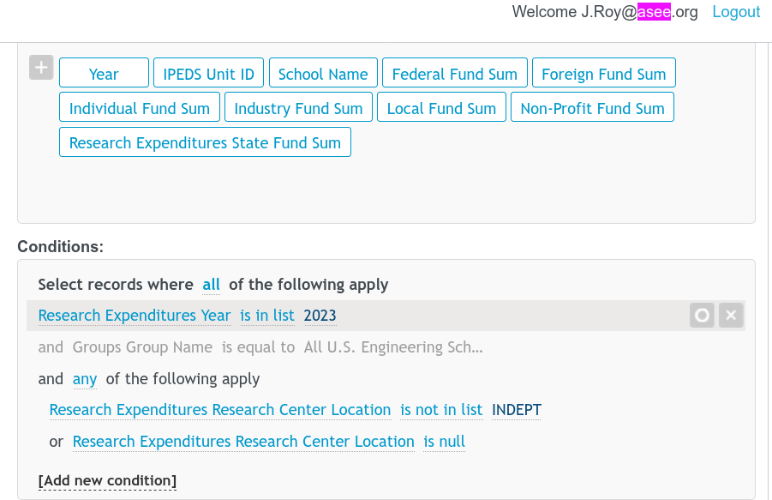
Research Expenditures

Slide 12
Excel Dashboard Creation Process
I uploaded the data files into Claude and described what I'd like the dashboard to look like:
It could produce react dashboards in Claude, but not an excel sheet.
It wrote the code to produce an excel dashboard that I iterated over several times to produce the final excel dashboard (that requires running the python code to generate it).

Slide 13
Thank you!
Questions can be directed to data@asee.org

